Slide 1

Instagram User Analytics
By Satyashree Sahu Pawar

Slide 2
Purpose:
The purpose of this project is to analyze user interactions and engagement with the Instagram app, providing valuable insights that can inform business decisions and contribute to the growth of the platform. As a data analyst working with the product team, the goal is to use MySQL Workbench to extract meaningful insights from the data, helping the team make informed decisions about the future direction of the Instagram app.

Slide 3
Tech-Stack Used
For this project, I used MySQL Workbench as the primary tool for working with the MySQL database. MySQL Workbench is a visual database design tool that provides a comprehensive set of features for database development, administration, and management

Slide 4
Insights
User Engagement: Identified top users based on post count, comment count, and follower count.Analyzed popular posts and user interactions to understand engagement patterns.
Hashtag Analysis: Determined the top five most commonly used hashtags on the platform.
User Registration Analysis: Analyzed user registration data to determine the day of the week with the highest registration activity.
Average Posts per User: Calculated the average number of posts per user, revealing insights into user posting behavior.
Identifying Potential user: Identified users who have liked every single photo on the site, potentially indicating automated or abnormal behavior.
Overall Recommendations: Provided actionable recommendations for marketing campaigns, such as targeting popular hashtags and optimizing ad scheduling.
Data Quality and Integrity: Ensured data consistency and integrity by understanding and utilizing foreign key relationships. Identified and addressed potential data anomalies or irregularities during the analysis.
Reporting and Visualization: Created reports and visualizations to communicate key metrics and trends effectively. Enhanced decision-making processes by presenting insights in a clear and accessible format.

Slide 5
Achievements and Impact:
Applied SQL in Real-world Scenario: Successfully applied SQL queries to a practical, real-world dataset, honing my skills in database management and analysis.
Understanding User Behavior: Gained valuable insights into user engagement, posting habits, and popular trends, contributing to a holistic understanding of user behavior on Instagram.
Data Integrity Awareness: Identified and addressed potential anomalies in data, enhancing awareness of the importance of maintaining data integrity for accurate analysis.
Enhanced Problem-Solving Skills: Developed problem-solving skills by addressing challenges in data exploration, query development, and deriving meaningful insights.

Slide 6
Marketing Analysis:

Slide 7
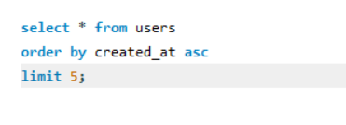

Loyal User Reward
five oldest users on Instagram
Darby_Herzog
Emilio_Bernier52
Elenor88
Nicole71
Jordyn.Jacobson2
80
67
63
95
38

Slide 8
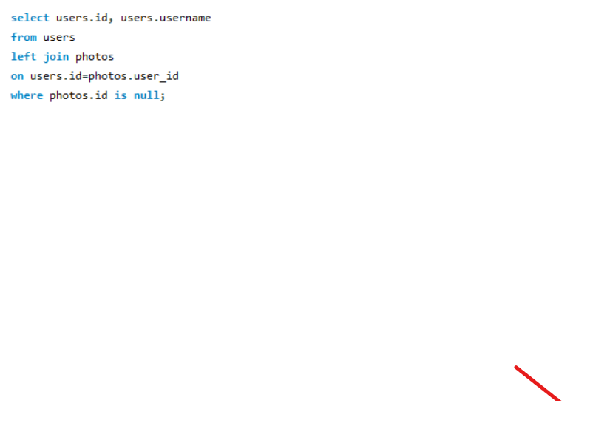
Inactive User Engagement
id | username
5 | Aniya_Hackett
7 | Kasandra_Homenick
14 | Jaclyn81
21 | Rocio33
24 | Maxwell.Halvorson
25 | Tierra.Trantow
34 | Pearl7
36 | Ollie_Ledner37
41 | Mckenna17
45 | David.Osinski47
49 | Morgan.Kassulke
53 | Linnea59
54 | Duane60
57 | Julien_Schmidt
66 | Mike.Auer39
68 | Franco_Keebler64
71 | Nia_Haag
74 | Hulda.Macejkovic
75 | Leslie67
76 | Janelle.Nikolaus81
80 | Darby_Herzog
81 | Esther.Zulauf61
83 | Bartholome.Bernhard
89 | Jessyca_West
90 | Esmeralda.Mraz57
91 | Bethany20
Detail of users who have never posted a single photo on Instagram.

Slide 9
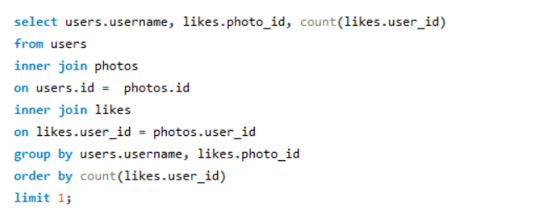

Contest Winner Declaration
The winner of the contest and provide their details to the team.
Travon.Waters

Slide 10
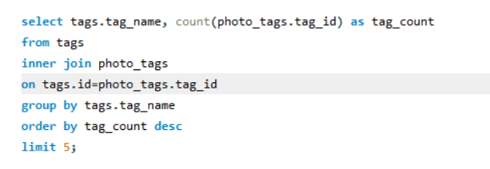
Hashtag Research:
The top five most commonly used hashtags on the platform.
#SMILE
# BEACH
#PARTY
#FUN
#CONCERT

Slide 11
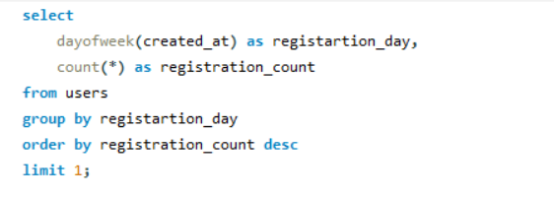
Ad Campaign Launch
The Best Time To Launch And Ad Campaign Are Sunday And Thursday
SUNDAY
16
THURSDAY
16

Slide 12
Investor Metrics:

Slide 13
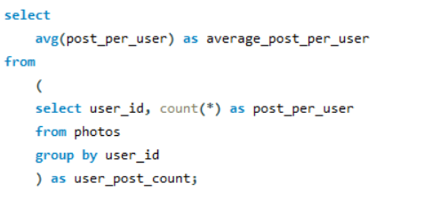
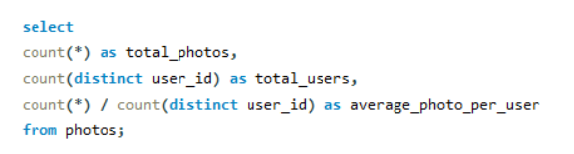
User Engagement
The average number of posts per user on Instagram.
The total number of photos on Instagram divided by the total number of users.
257
74
3.47
Total Photos
Average Photo per user
Total Users

Slide 14
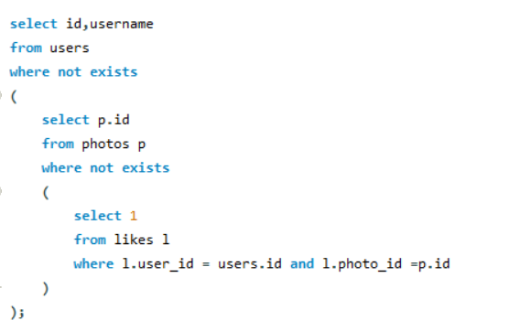
Bots & Fake Accounts:
The users who have liked every single photo on the site will be considered as bots
id | username
5 | Aniya_Hackett
14 | Jaclyn81
21 | Rocio33
24 | Maxwell.Halvorson
36 | Ollie_Ledner37
41 | Mckenna17
54 | Duane60
57 | Julien_Schmidt
66 | Mike.Auer39
71 | Nia_Haag
75 | Leslie67
76 | Janelle.Nikolaus81
91 | Bethany20

